Slide 1

Walk Assist : Innovative Smart Footwear for the Visually Impaired
GUIDED BY:
Name : Mr. E SANTHOSH
Designation : AP(Assistant Professor)
SARAVANAN N-732721106032
Bharathkumar M-732721106005
Salinth d-732721106030

Slide 2
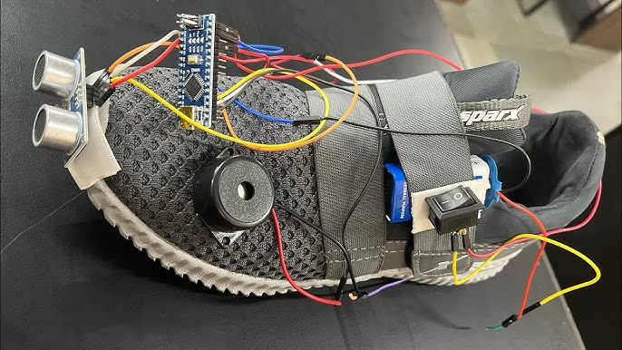
OBJECTIVE
The objective of developing a smart shoe for the visually impaired is to enhance their independence, safety, and overall quality of life by leveraging technology to provide them with a reliable and inherent navigation and sensory aid. This innovative footwear solution aims to address the unique challenges faced by individuals with visual impairments, ultimately empowering them to navigate their surroundings with confidence and ease

Slide 3
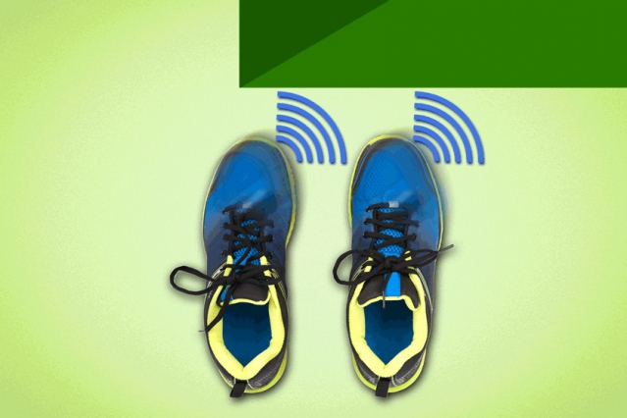
ABSTRACT
Here, we will develop shoes which can serve as a blind stick being more efficient and helpful than the conventional one.
Our project advanced shoes mainly based on the ultrasonic sensor which is sense the object near the shoes and alert the blind person.

Slide 4
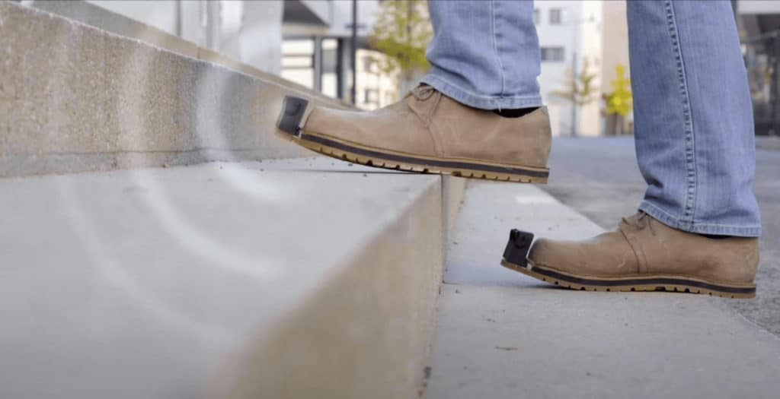
SCOPE
It is used in inside home and outsides like streets, roads to detect the obstacles in path.
It is used to climb and stepdown the stairs.
It is also useful for detecting pits in path.
It will useful for lifetime because of using rechargeable battery.

Slide 5
LITERATURE REVIEW
1. Smart Shoe for Visually Impaired
This paper presents a Shoes which is integrated with ultrasonic sensors, vibration sensors and Bluetooth. These shoes can direct the user to his destination and can alert him about the impending obstacles on the path via the attached vibration sensors. The system needs to be improved as there is no provision for water detection and the components of the shoes can get damaged if it comes in contact with water. Again there is no provision for counting the number of steps to the obstacle.
2. Smart Navigational shoes for the blind obstacle detection
This paper presents a Shoes with Sensors will detect obstacles and vibrators will vibrate according to direction. IR sensor is utilized for obstacle detection. In the project that the obstacle is distinguished out and about then buzzer will turn ON. Additionally if the water is available on street it will distinguish by water sensor lastly this information will show on LCD. However, this project needs to be modified as there no provision for counting the number of steps to the obstacle.

Slide 6
3. Advanced Shoes for blind people
Advanced shoes can detect the obstacles within a particular distance with the help of ultrasonic sensors and the vibration sensors will vibrate in the direction of detected obstacle. As this project doesn’t have water sensor, the shoes will get damaged in presence of water. The project doesn’t have the provision to find the route to destination as there is no attached GPS and also as there is no step counter, the exact position of obstacle cannot be determined.
4. Wearable Obstacle Detection System for Visually Impaired People
This paper presents an obstacle detection system that can alert the blind people about obstacles while travelling. The proposed system can detect the nearest obstacle via a ultrasonic sensor system and sends back a Vibro-Tactile feedback to inform the user about its location. The main aim of the system is to increase the mobility of visually impaired people by offering new sensing abilities. The system needs to be improved as there is no water sensor and shoes can get damaged in water, also a step counter need to be installed for locating the exact position of obstacle.

Slide 7
5. Wearable navigation assistance-a tool for the blind
This paper describes tool for navigation for visually impaired persons. The system includes a multi-sensory system (comprising stereo vision, acoustic range finding and movement sensors), a mapper, a warning system and a tactile human-machine interface. The goal of the project is to provide an electronic tool for the blind to navigate. The system provides information about the direct surroundings to blind to help him move without collisions. The system needs to be improved as there is no water sensor and shoes can get damaged in water, also a step counter need to be installed for locating the exact position of obstacle.

Slide 8
PROPOSED METHODOLOGY
NOVELTY:
We were using piezoelectric sensors for generating electricity. It is used for recharge the battery.
Taking a step towards a brighter future for the visually impaired with our smart shoe – where every step not only leads you forward but also generates the power to light your way.

Slide 9
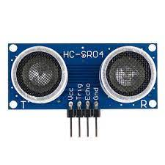
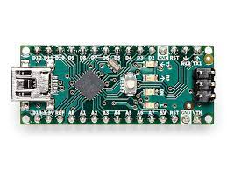
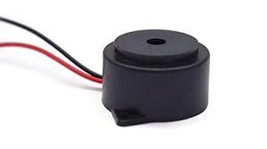
HARDWARE COMPONENTS
Ultra Sonic Sensor
Arduino Nano v3.0
Buzzer

Slide 10
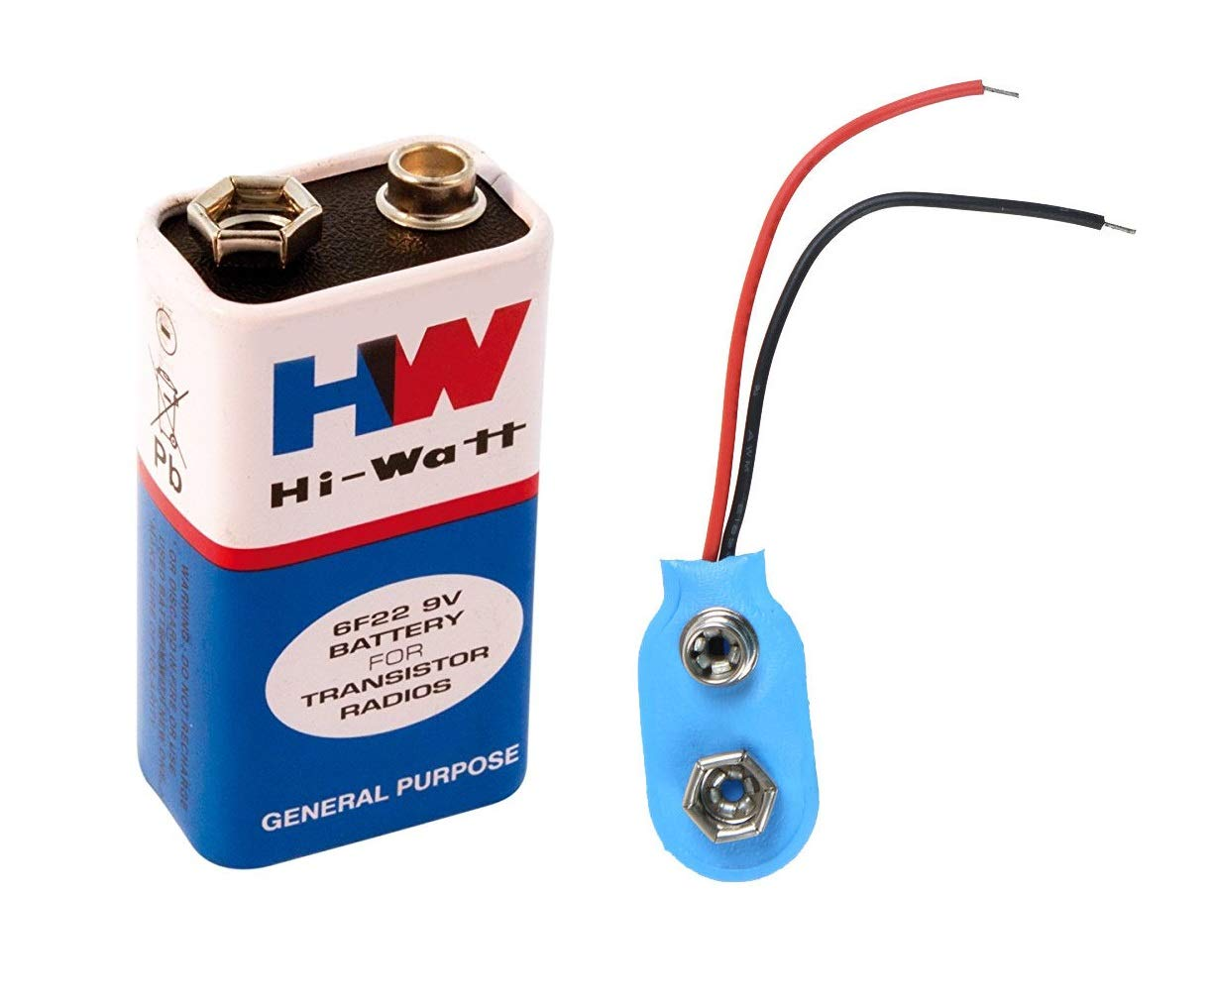
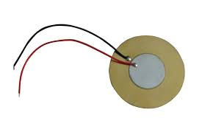
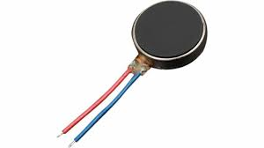
HARDWARE COMPONENTS
Piezo Electric Sensor
Vibration Motor
Battery 9 volt

Slide 11
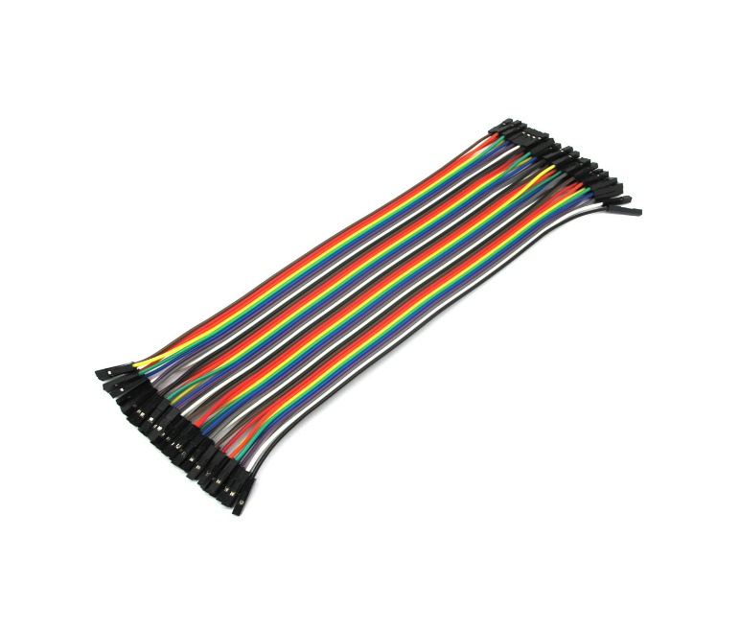
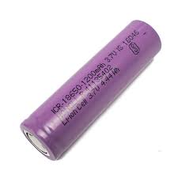
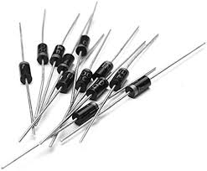
HARDWARE COMPONENTS
LI-ION Rechargeable Battery
1N4007 Diode
Connecting Wires

Slide 12

SOFTWARE REQUIREMENTS
Arduino IDE Software
Website : https://www.arduino.cc/en/software

Slide 13
BLOCK DIAGRAM FOR SMART SHOE
Arduino Nano
Object
User
Ultra Sonic Sensor
Vibration Motor
Piezoelectric Sensor
Battery

Slide 14
BLOCK DIAGRAM FOR CHEST MOUNTED ALERT SYSTEM
Arduino Nano
User
Object
Buzzer
Ultra Sonic Sensor

Slide 15
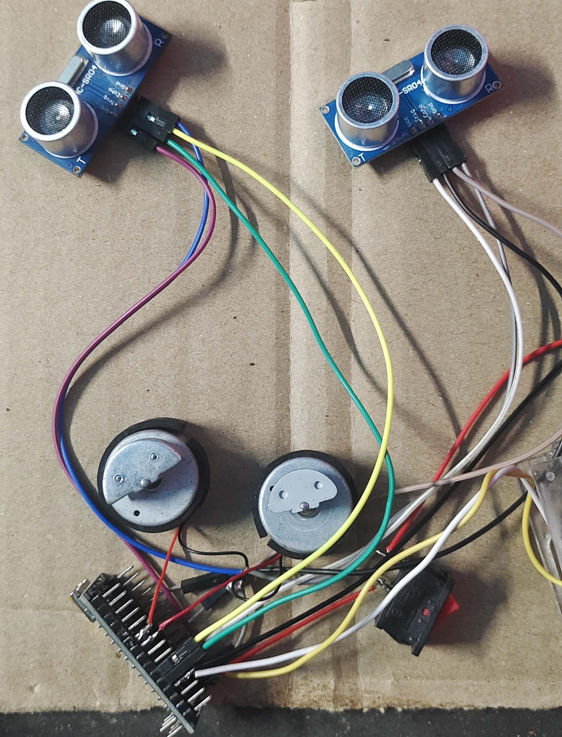
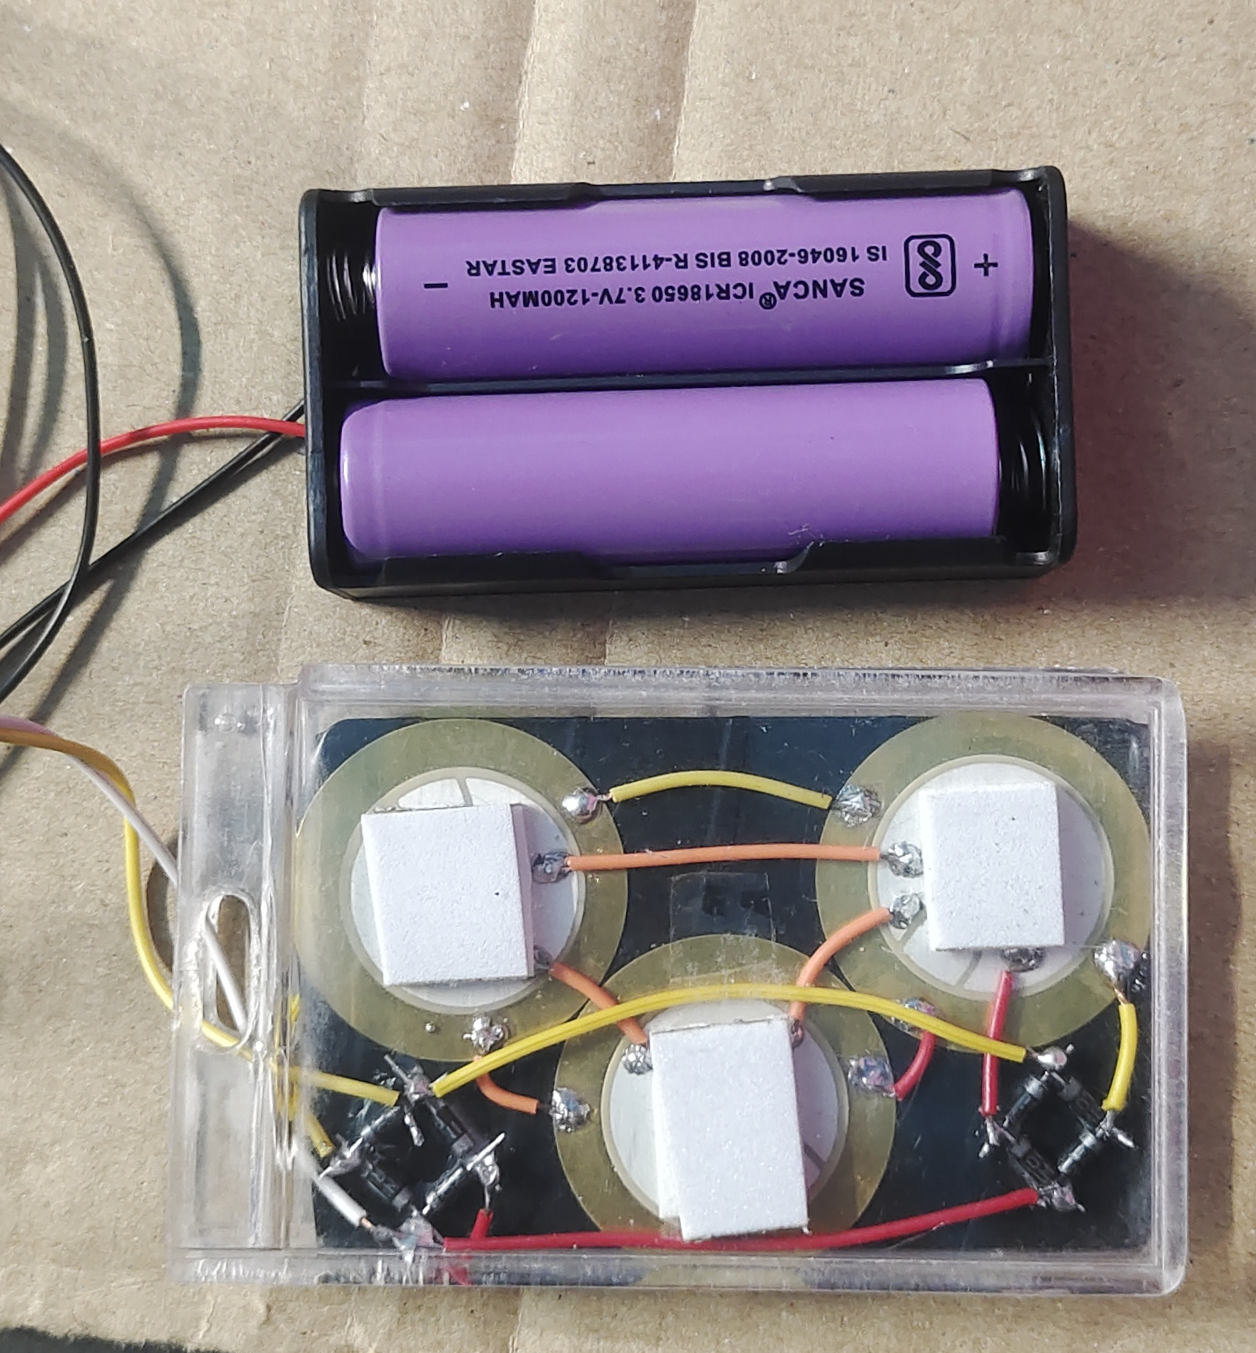
RESULTS - Output for Smart Footwear
Rechargeable Battery with Piezoelectric Sensors
Sensor and Vibration Motor Working output

Slide 16
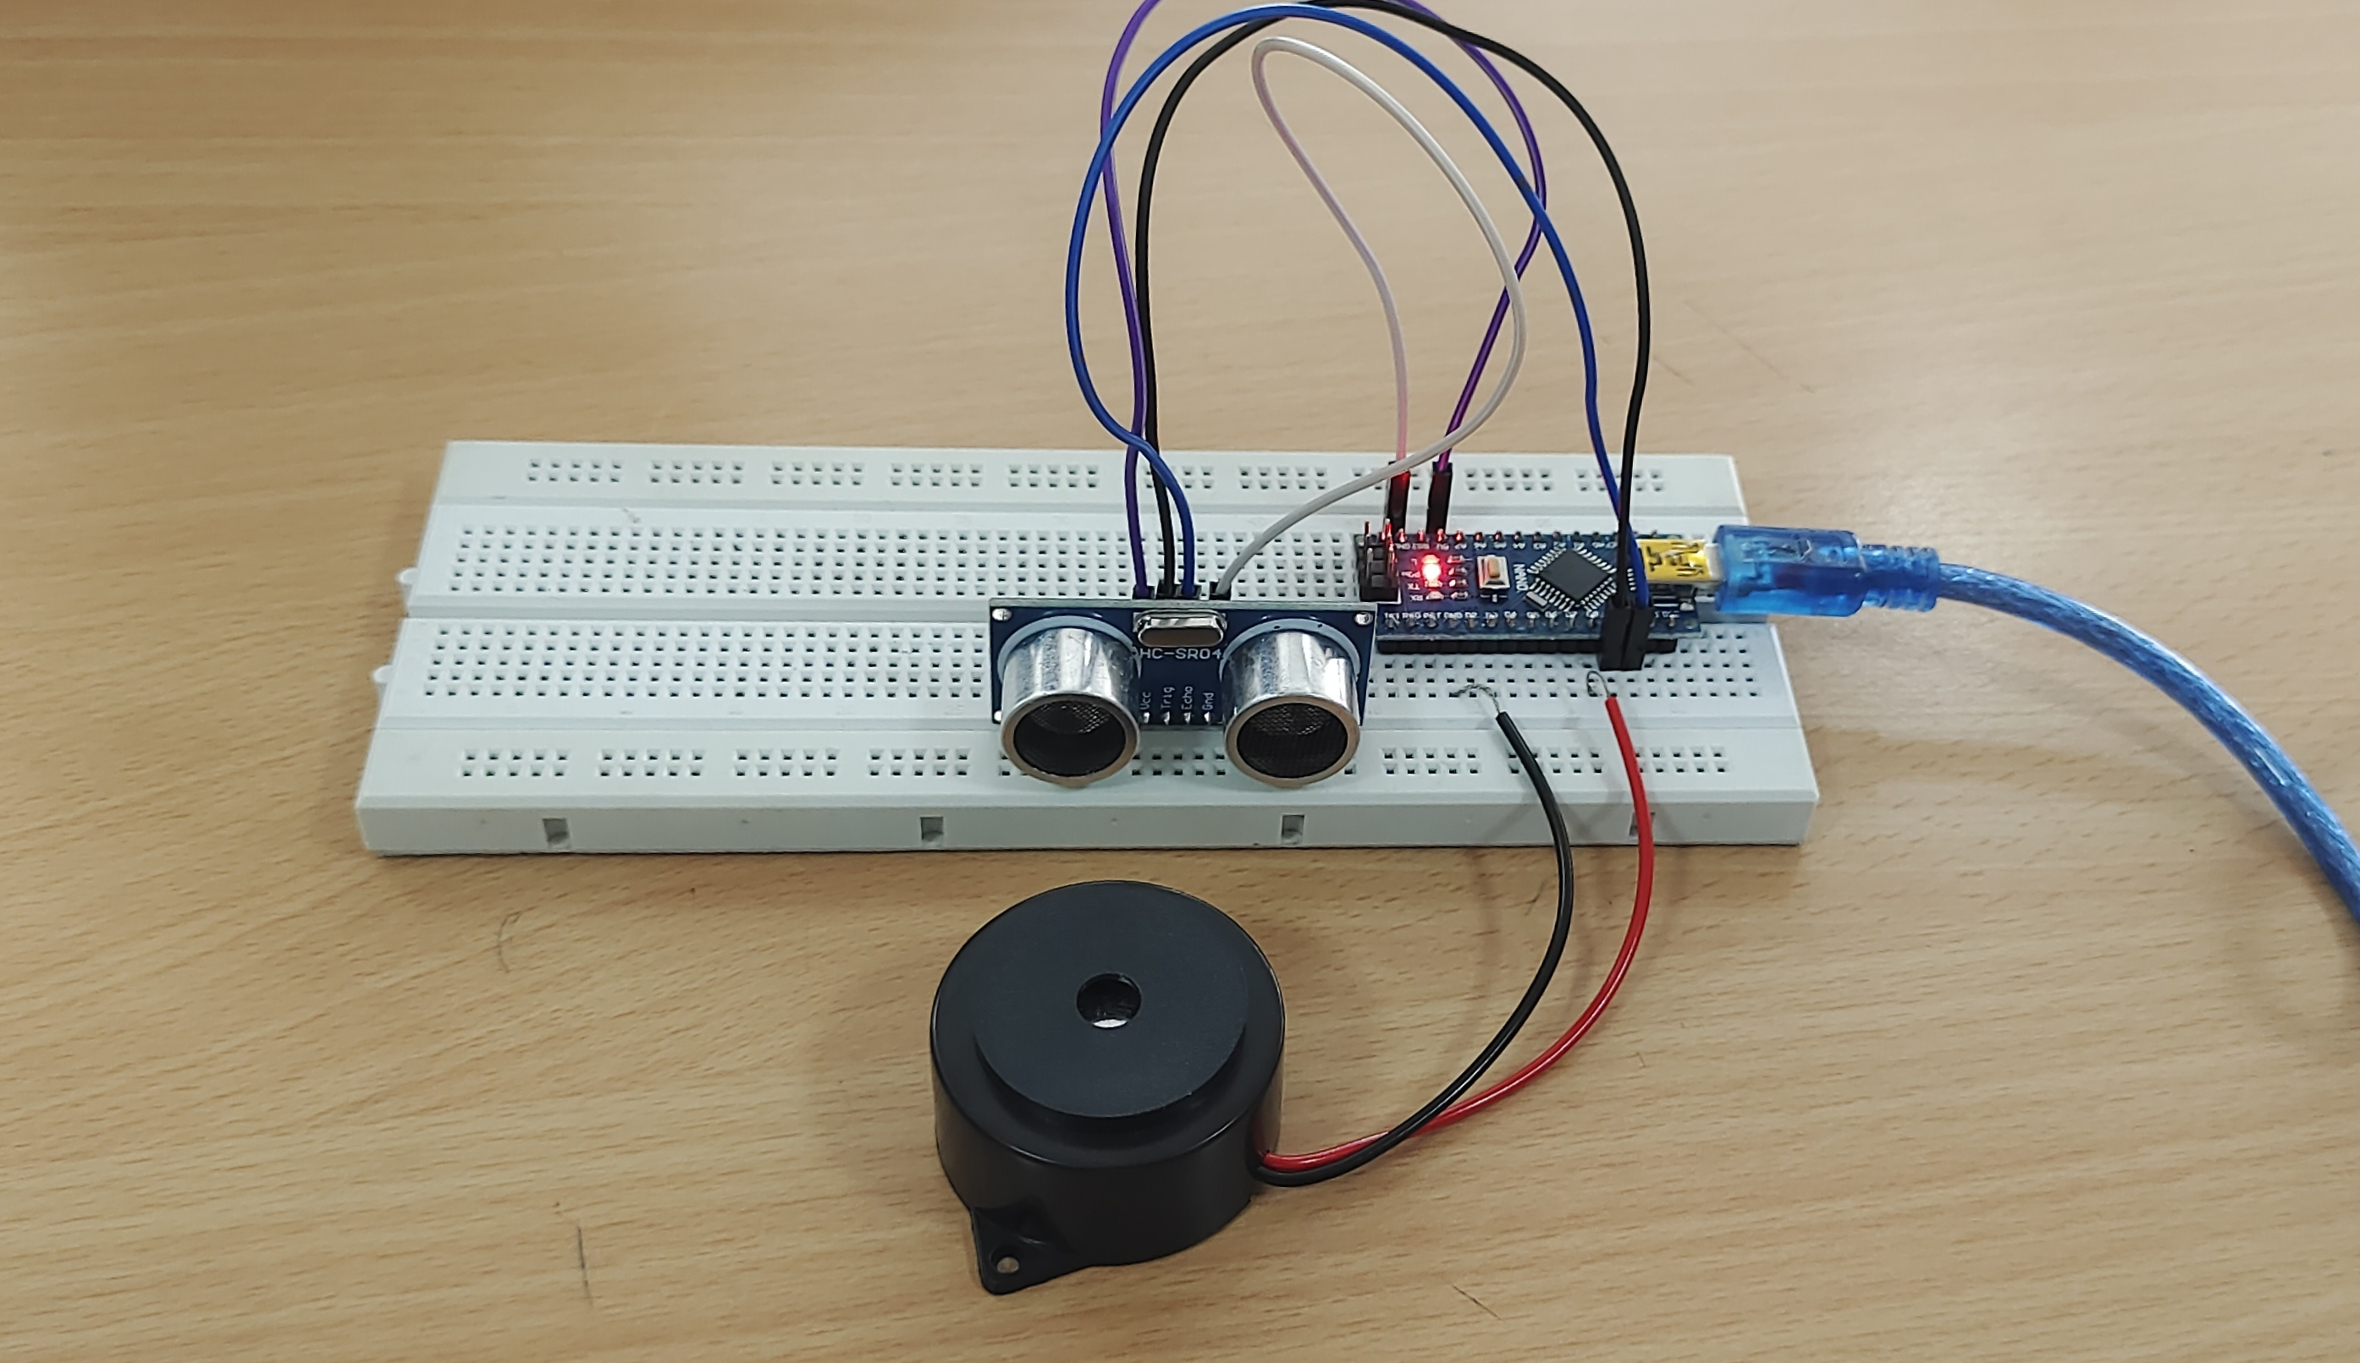
RESULT FOR CHEST MOUNTED ALERT SYSTEM

Slide 17
REFERENCES
P.E.Darney, A.E.Muthu, K.Jeyakumar, R.S.Krishnan, K L.Narayanan and Y.H.Robinson, "IoT based Smart Shoes for Blind people," 2022 3rd International Conference on Electronics and Sustainable Communication Systems (ICESC), Coimbatore, India, 2022, pp. 524-529, doi: 10.1109/ICESC54411.2022.9885322.
T. Chava, A. T. Srinivas, A. L. Sai and V. Rachapudi, "IoT based Smart Shoe for the Blind," 2021 6th International Conference on Inventive Computation Technologies (ICICT), Coimbatore, India, 2021, pp. 220-223, doi: 10.1109/ICICT50816.2021.9358759
G.Prasanthi, P.Tejaswitha “ Sensor assisted stick for the blind people” Transactions on Engineering and Sciences- Issue IX, March 2017 www.ijesird.com, e-ISSN: 2349-6185
M. Arunkumar and E. Lokesh, "IoT-Based Navigation Assistance for Visually Impaired People," 2023 Eighth International Conference on Science Technology Engineering and Mathematics (ICONSTEM), Chennai, India, 2023, pp. 1-4, doi: 10.1109/ICONSTEM56934.2023.10142780.
S. K. Mahadeva, K. Walus and B. Stoeber, "Piezoelectric paper for physical sensing applications," 2015 28th IEEE International Conference on Micro Electro Mechanical Systems (MEMS), Estoril, Portugal, 2015, pp. 861-864, doi: 10.1109/MEMSYS.2015.7051095.

Slide 18
THANK YOU

